Slide 1
Deadlocks
Chapter 6
6.1. Resource
6.2. Introduction to deadlocks
6.3. The ostrich algorithm
6.4. Deadlock detection and recovery
6.5. Deadlock avoidance
6.6. Deadlock prevention

Slide 2
Introduction
Computer systems are full of resources that can be used only by one process at a time. Common examples include printers, tape drives for backing up company data, Blu-ray recorder,... For many applications, a process needs exclusive access to not one resource, but several. Suppose, for example, two processes each want to record a scanned document on a Blu-ray disc. Process A requests permission to use the scanner and is granted it. Process B is programmed differently and requests the Blu-ray recorder first and is also granted it. Now A asks for the Blu-ray recorder, but the request is suspended until B releases it. Unfortunately, instead of releasing the Blu-ray recorder, B asks for the scanner. At this point both processes are blocked and will remain so forever. This situation is called a deadlock.

Slide 3
Computer Resources
A major class of deadlocks involves resources to which some process has been granted exclusive access. These resources include devices, data records, files, and so forth. To make the discussion of deadlocks as general as possible, we will refer to the objects granted as resources. A resource can be a hardware device (e.g., a Blu-ray drive) or a piece of information (e.g., a record in a database). A computer will normally have many different resources that a process can acquire. For some resources, several identical instances may be available, such as three Blu-ray drives. When several copies of a resource are available, any one of them can be used to satisfy any request for the resource. In short, a resource is anything that must be acquired, used, and released over the course of time.

Slide 4
Preemptable and Nonpreemptable resources
Resources come in two types: preemptable and nonpreemptable. A preemptable resource is one that can be taken away from the process owning it with no ill effects. Memory is an example of a preemptable resource: data related to a process can be swapted out/in from/to it. A nonpreemptable resource, in contrast, is one that cannot be taken away from its current owner without potentially causing failure. Blu-ray recorders are not preemptable at an arbitrary moment.
In general, deadlocks involve nonpreemptable resources. Potential deadlocks that involve preemptable resources can usually be resolved by reallocating resources from one process to another. Thus, our treatment will focus on nonpreemptable resources.

Slide 5
Multex
Mutex or Mutual Exclusion Object is used to give access to a resource to only one process at a time. The mutex object allows all the processes to use the same resource but at a time, only one process is allowed to use the resource. Mutex uses the lock-based technique to handle the critical section problem.
Whenever a process requests for a resource from the system, then the system will create a mutex object with a unique name or ID. So, whenever the process wants to use that resource, then the process occupies a lock on the object. After locking, the process uses the resource and finally releases the mutex object. After that, other processes can create the mutex object in the same manner and use it.
By locking the object, that particular resource is allocated to that particular process and no other process can take that resource. So, in the critical section, no other processes are allowed to use the shared resource. In this way, the process synchronization can be achieved with the help of a mutex object.

Slide 6
Semaphore
Semaphore is an integer variable S, that is initialized with the number of resources present in the system and is used for process synchronization. It uses two functions to change the value of S i.e. wait() and signal(). Both these functions are used to modify the value of semaphore but the functions allow only one process to change the value at a particular time i.e. no two processes can change the value of semaphore simultaneously. There are two categories of semaphores i.e. Counting semaphores and Binary semaphores.

Slide 7
Counting semaphore
In Counting semaphores, firstly, the semaphore variable is initialized with the number of resources available. After that, whenever a process needs some resource, then the wait() function is called and the value of the semaphore variable is decreased by one. The process then uses the resource and after using the resource, the signal() function is called and the value of the semaphore variable is increased by one. So, when the value of the semaphore variable goes to 0 i.e all the resources are taken by the process and there is no resource left to be used, then if some other process wants to use resources then that process has to wait for its turn. In this way, we achieve the process synchronization.

Slide 8
Binary semaphore
In Binary semaphores, the value of the semaphore variable will be 0 or 1. Initially, the value of semaphore variable is set to 1 and if some process wants to use some resource then the wait() function is called and the value of the semaphore is changed to 0 from 1. The process then uses the resource and when it releases the resource then the signal() function is called and the value of the semaphore variable is increased to 1. If at a particular instant of time, the value of the semaphore variable is 0 and some other process wants to use the same resource then it has to wait for the release of the resource by the previous process. In this way, process synchronization can be achieved. It is similar to mutex but here locking is not performed.

Slide 9
Steps required to use a resource
The abstract sequence of events required to use a resource is given below. 1. Request the resource. 2. Use the resource. 3. Release the resource. If the resource is not available when it is requested, the requesting process is forced to wait. In some operating systems, the process is automatically blocked when a resource request fails, and awakened when it becomes available. In other systems, the request fails with an error code, and it is up to the calling process to wait a little while and try again.

Slide 10
Resource acquisition (1)
For some kinds of resources, such as records in a database system, it is up to the user processes rather than the system to manage resource usage themselves. One way of allowing this is to associate a semaphore with each resource. These semaphores are all initialized to 1. Mutexes can be used equally well. The three steps listed above are then implemented as a down on the semaphore to acquire the resource, the use of the resource, and finally an up on the resource to release it. These steps are shown in Fig. (a) below.

Slide 11
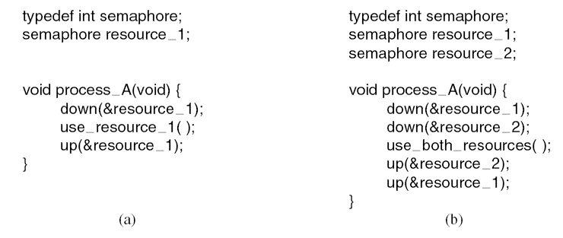
Resource acquisition (2)
Using a semaphore to protect resources.
(a) One resource. (b) Two resources.

Slide 12
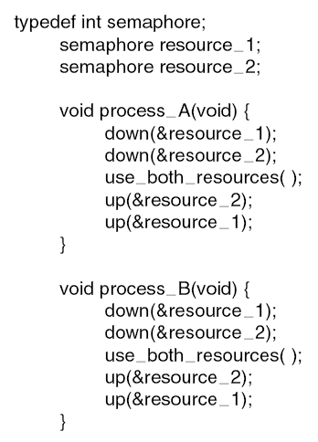
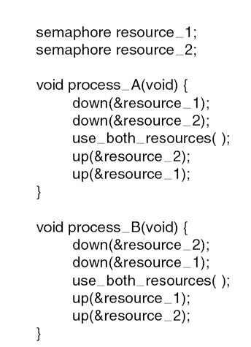
Resource acquisition (3)
A
R1
R2
B
(a) Deadlock-free code
(b) Code with potential deadlock

Slide 13
Deadlocks
Formal definition :
A set of processes is deadlocked if each process in the set is waiting for an event that only another process in the set can cause.
Usually the event is release of a currently held resource
None of the processes can …
Run
Release resources
Be awakened
Notes:
Event - hendelse

Slide 14
Conditions for Resource Deadlocks
1. Mutual exclusion condition. Each resource is either currently assigned to exactly one process or is available.
2. Hold-and-wait condition. Processes currently holding resources that were granted earlier can request new resources.
3. No-preemption condition. Resources previously granted cannot be forcibly taken away from a process. They must be explicitly released by the process holding them.
4. Circular wait condition. There must be a circular list of two or more processes, each of which is waiting for a resource held by the next member of the chain.
Notes:
Gjensidig utelukkelse
Hold og vent
Ingen

Slide 15
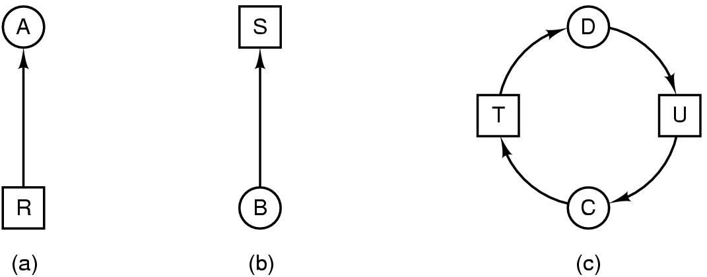
Deadlock Modeling (1)
Modeled with directed graphs
Resource R assigned to process A
Process B is requesting/waiting for resource S
Process C and D are in deadlock over resources T and U

Slide 16
Deadlock Modeling (2)
How deadlock occurs
A
Requests R
Requests S
Releases S
Releases R
A requests R
B requests S
C requests T
A requests S
B requests T
C requests R
Processes
A
B
C
B
Requests S
Requests T
Releases T
Releases S
Resources
R
S
T
C
Requests T
Requests R
Releases R
Releases T

Slide 17
Deadlock Modeling (3)
How deadlock can be avoided
A
Requests R
Requests S
Releases S
Releases R
A requests R
C requests T
A requests S
B requests S
B requests T
C requests R
A releases S
A releases R
C releases R
C releases T
Processes
A
B
C
B
Requests S
Requests T
Releases T
Releases S
Resources
R
S
T
C
Requests T
Requests R
Releases R
Releases T

Slide 18
Strategies for dealing with Deadlocks
1. Just ignore the problem (The Ostrich Algorithm). Maybe if you ignore it, it will ignore you.
2. Detection and recovery. Let them occur, detect them, and take action. 3. Dynamic avoidance by careful resource allocation. 4. Prevention, by structurally negating one of the four conditions.
Notes:
Gjensidig utelukkelse
Hold og vent
Ingen

Slide 19
The Ostrich Algorithm
Pretend there is no problem
Reasonable if
Deadlocks occur very rarely
Cost of prevention is high
UNIX and Windows take this approach
It is a trade-off between
Convenience
Correctness

Slide 20
Deadlock Detection and Recovery
A second technique is detection and recovery. When this technique is used, the system does not attempt to prevent deadlocks from occurring. Instead, it lets them occur, tries to detect when this happens, and then takes some action to recover after the fact. In this section we will look at some of the ways deadlocks can be detected and some of the ways recovery from them can be handled.

Slide 21
One Resource of Each Type (1)
Deadlock Detection and Recovery
Let us begin with the simplest case: there is only one resource of each type. Such a system might have one scanner, one Blu-ray recorder, one plotter, and one tape drive, but no more than one of each class of resource. In other words, we are excluding systems with two printers for the moment. We will treat them later, using a different method. For such a system, we can construct a resource graph of the sort illustrated in Fig. in next slide. If this graph contains one or more cycles, a deadlock exists. Any process that is part of a cycle is deadlocked. If no cycles exist, the system is not deadlocked.

Slide 22
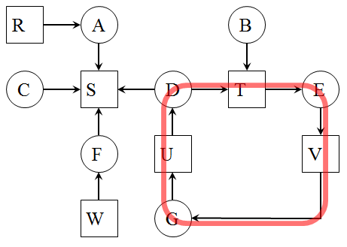
One Resource of Each Type (2)
Deadlock Detection and Recovery
Process A holds R and wants S.
Process B holds nothing but wants T.
Process C holds nothing but wants S.
Process D holds U and wants S and T.
Process E holds T and wants V.
Process F holds W and wants S.
Process G holds V and wants U.
The question is: ‘‘Is this system deadlocked, and if so, which processes are involved?’’
To answer this question, we can construct the resource graph. This graph contains one cycle, which can be seen by visual inspection. The cycle is shown. From this cycle, we can see that processes D, E, and G are all deadlocked.

Slide 23
Multiple Resources of Each Type (1)
Deadlock Detection and Recovery
When multiple copies of some of the resources exist, a different approach is needed to detect deadlocks. We will now present a matrix-based algorithm for detecting deadlock among n processes, P₁ through P_{n}. Let the number of resource classes be m, with E₁ resources of class 1, E₂ resources of class 2, and generally, E_{i} resources of class i (1 ≤ i ≤ m). E is the existing resource vector. It gives the total number of instances of each resource in existence. For example, if class 1 is tape drives, then E₁ = 2 means the system has two tape drives. At any instant, some of the resources are assigned and are not available. Let A be the available resource vector, with A_{i} giving the number of instances of resource i that are currently available (i.e., unassigned). If both of our two tape drives are assigned, A₁ will be 0.
Now we need two arrays, C, the current allocation matrix, and R, the request matrix. The ith row of C tells how many instances of each resource class P_{i} currently holds. Thus, C_{ij} is the number of instances of resource j that are held by process i. Similarly, R_{ij} is the number of instances of resource j that P_{i} wants.

Slide 24
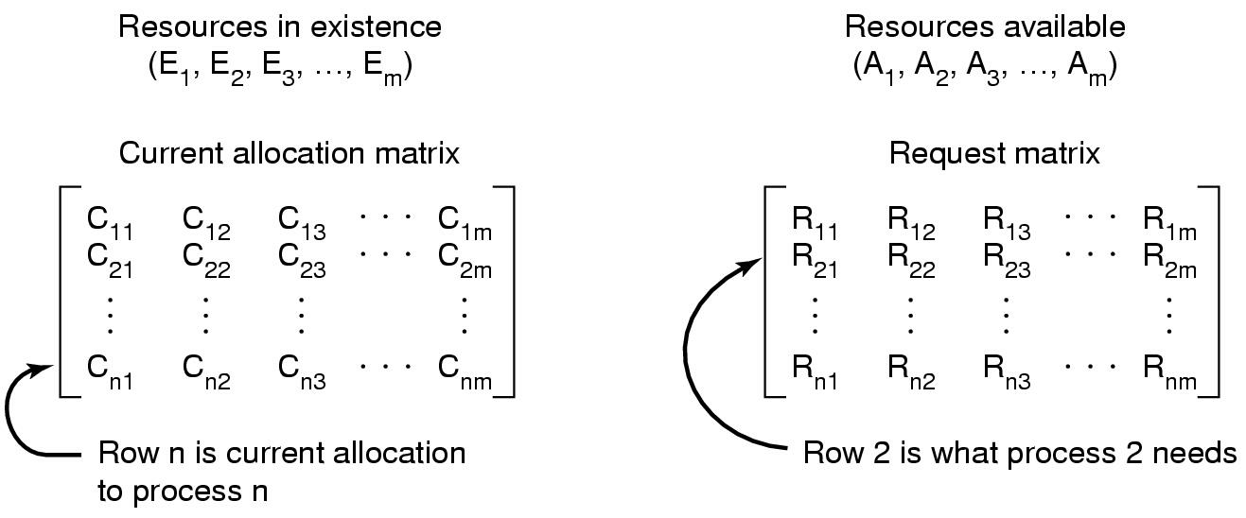
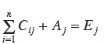
Multiple Resources of Each Type (2)
Deadlock Detection and Recovery
Data structures needed by deadlock detection algorithm. In particular, every resource is either allocated or is available. This observation means that

Slide 25
Multiple Resources of Each Type (3)
Deadlock Detection and Recovery
The deadlock detection algorithm:
Look for unmarked process, P_{i}, for which the
i-th row of R is less than or equal to A
If such process is found, add the i-th row of C to A , mark the process and go back to step 1
If no such process exists, the algorithm terminates.
When algorithm terminates, any unmarked processes
are known to be dealocked

Slide 26
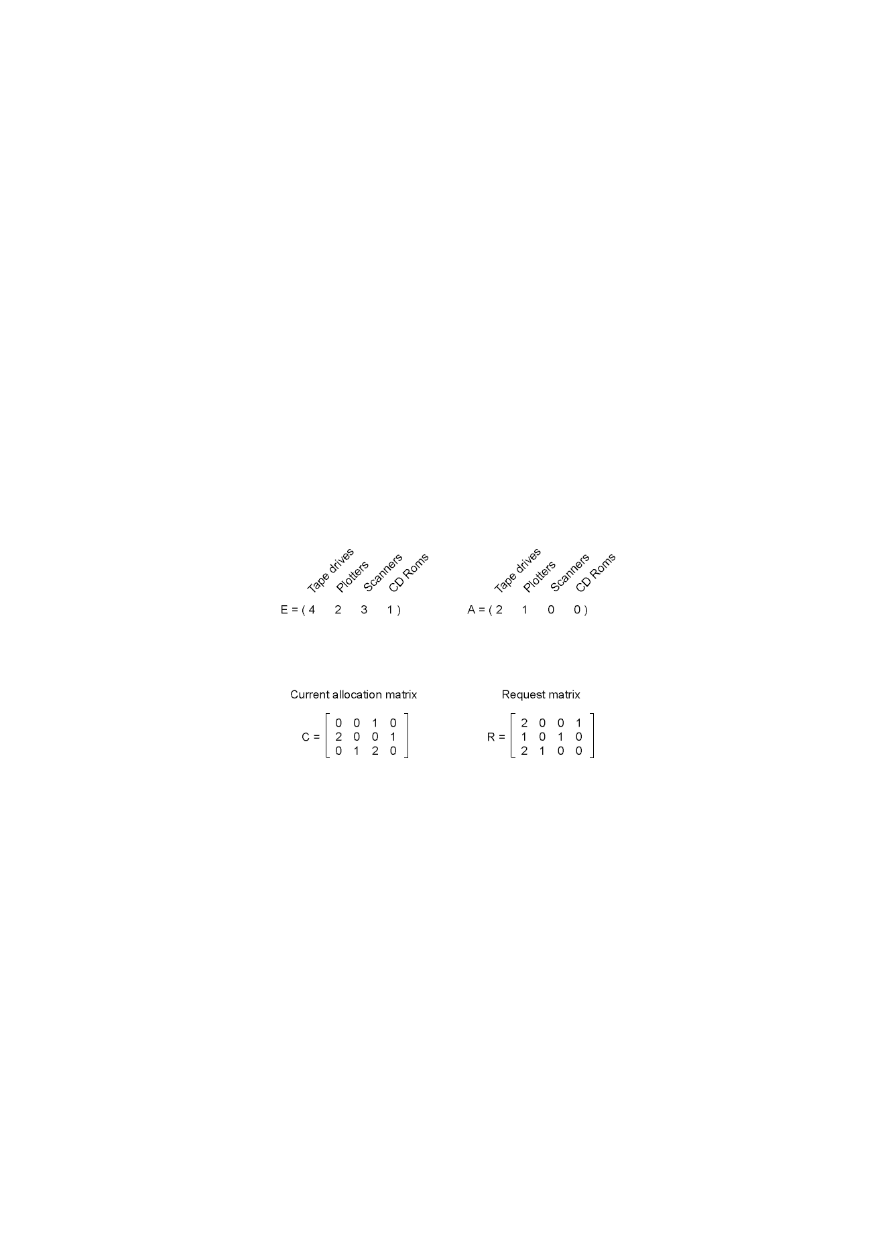
Multiple Resources of Each Type (4a)
Deadlock Detection and Recovery
To run the deadlock detection algorithm, we look for a process whose resource request can be satisfied. The first one cannot be satisfied because there is no Blu-ray drive available. The second cannot be satisfied either, because there is no
An example for the deadlock detection algorithm.
scanner free. Fortunately, the third one can be satisfied, so process 3 runs and eventually returns all its resources, giving
A = (2 2 2 0)
At this point process 2 can run and return its resources, giving
A = (4 2 2 1)
Now the remaining process can run. There is no deadlock in the system.

Slide 27
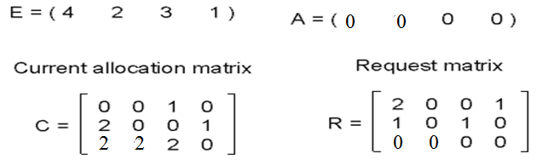

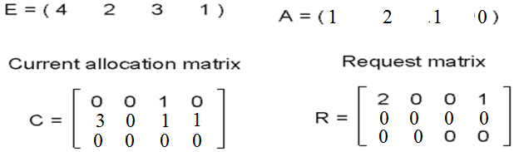

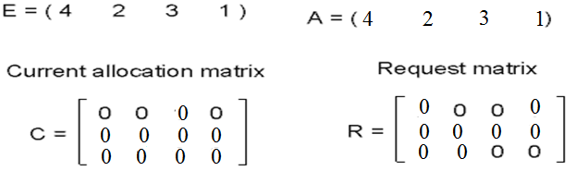
Multiple Resources of Each Type (4b)
Deadlock Detection and Recovery

Slide 28
Recovery from Deadlock
Deadlock Detection and Recovery
Suppose that our deadlock detection algorithm has succeeded and detected a deadlock. What next? Some way is needed to recover and get the system going again. In this section we will discuss various ways of recovering from deadlock. None of them are especially attractive, however.
Recovery through preemption
Take a resource from some other process
Depends on nature of the resource
Recovery through rollback
Checkpoint a process periodically
Use this saved state
Restart the process if it is found deadlocked
Recovery through killing processes
Crudest but simplest way to break a deadlock
Kill one of the processes in the deadlock cycle
The other processes get its resources
Choose process that can be rerun from the beginning

Slide 29
Deadlock Avoidance
In the discussion of deadlock detection, we tacitly assumed that when a process asks for resources, it asks for them all at once (the R matrix). In most systems, however, resources are requested one at a time. The system must be able to decide whether granting a resource is safe or not and make the allocation only when it is safe. Thus, the question arises: Is there an algorithm that can always avoid deadlock by making the right choice all the time? The answer is a qualified yes—we can avoid deadlocks, but only if certain information is available in advance. In this section we examine ways to avoid deadlock by careful resource allocation.

Slide 30
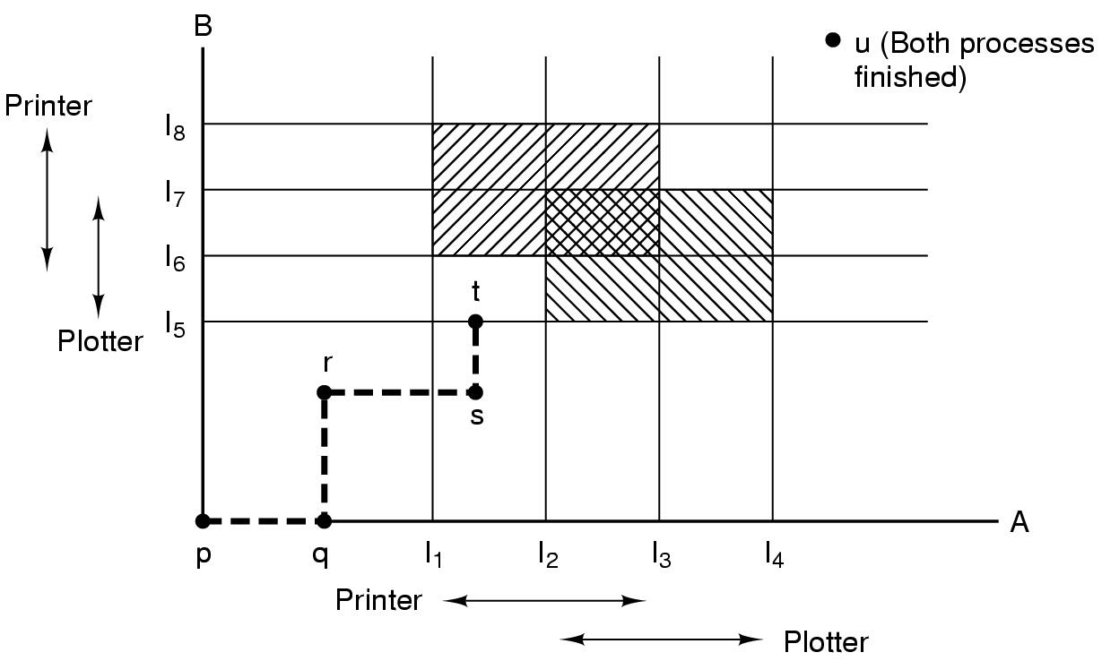
Resource Trajectories (1)
Deadlock Avoidance
In Fig. below we see a model for dealing with two processes and two resources, for example, a printer and a plotter. The horizontal axis represents the number of instructions executed by process A. The vertical axis represents the number of instructions executed by process B. At I₁ A requests a printer; at I₂ it needs a plotter. The printer and plotter are released at I₃ and I₄, respectively. Process B needs the plotter from I₅ to I₇ and the printer from I₆ to I₈.
Every point in the diagram represents a joint state of the two processes. Initially, the state is at p, with neither process having executed any instructions. If the scheduler chooses to run A first, we get to the point q, in which A has executed some number of instructions, but B has executed none. At point q the trajectory becomes vertical, indicating that the scheduler has chosen to run B. With a single processor, all paths must be horizontal or vertical, never diagonal.
Two process resource ies

Slide 31
Resource Trajectories (2)
Deadlock Avoidance
If the system ever enters the box bounded by I1 and I2 on the sides and I5 and I6 top and bottom, it will eventually deadlock when it gets to the intersection of I2 and I6 . At this point, A is requesting the plotter and B is requesting the printer, and both are already assigned. The entire box is unsafe and must not be entered. At point t the only safe thing to do is run process A until it gets to I4 . Beyond that, any trajectory to u will do.
The important thing to see here is that at point t, B is requesting a resource. The system must decide whether to grant it or not. If the grant is made, the system will enter an unsafe region and eventually deadlock. To avoid the deadlock, B should be suspended until A has requested and released the plotter.
Two process resource trajectories

Slide 32
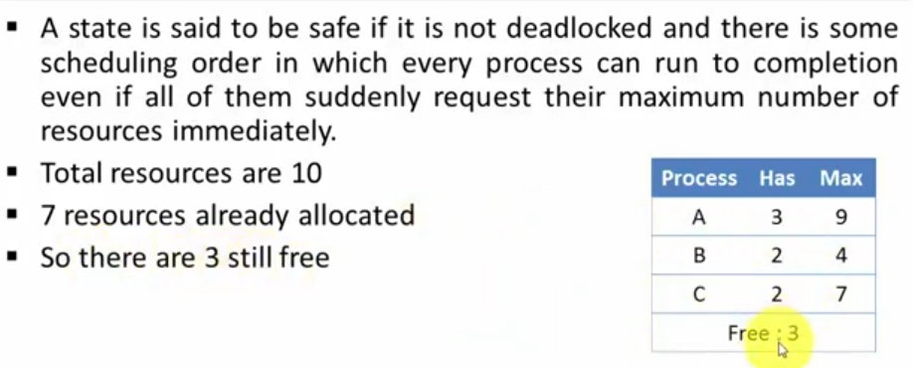
Safe and Unsafe States (1)
Deadlock Avoidance
Example for safe state

Slide 33
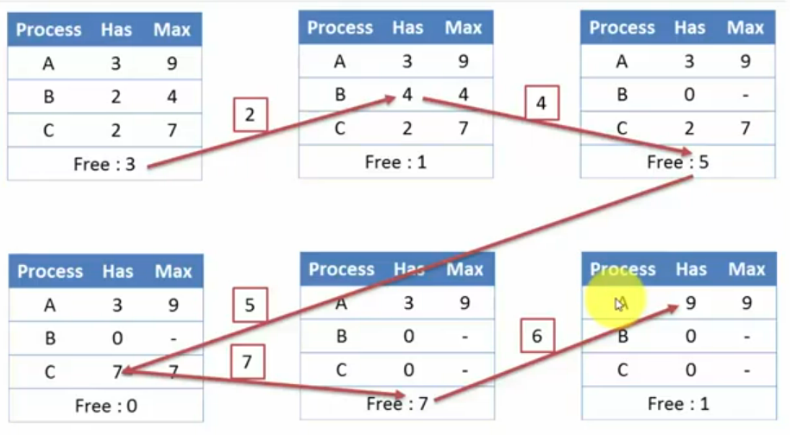
Safe and Unsafe States (2)
Deadlock Avoidance
Example for safe state

Slide 34
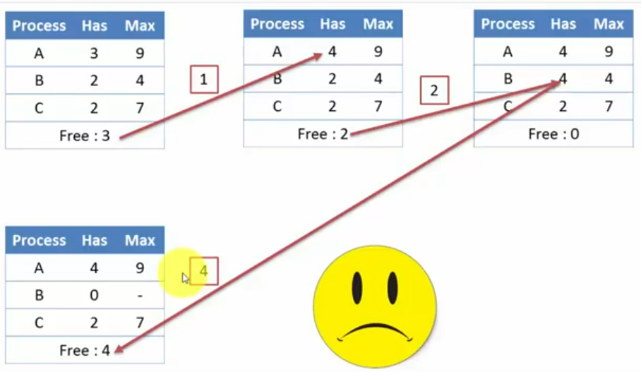
Safe and Unsafe States (2)
Deadlock Avoidance
Example for unsafe state

Slide 35
Banker’s Algorithm for a Single Resource (1)
Deadlock Avoidance
A scheduling algorithm that can avoid deadlocks is due to Dijkstra (1965); it is known as the banker’s algorithm and is an extension of the deadlock detection algorithm. It is modeled on the way a small-town banker might deal with a group of customers to whom he has granted lines of credit. What the algorithm does is check to see if granting the request leads to an unsafe state. If so, the request is denied. If granting the request leads to a safe state, it is carried out. In Fig. (a) below we see four customers, A, B, C, and D, each of whom has been granted a certain number of credit units (e.g., 1 unit is 1K dollars). The banker knows that not all customers will need their maximum credit immediately, so he has reserved only 10 units rather than 22 to service them. (In this analogy, customers are processes, units are, say, tape drives, and the banker is the operating system.)

Slide 36
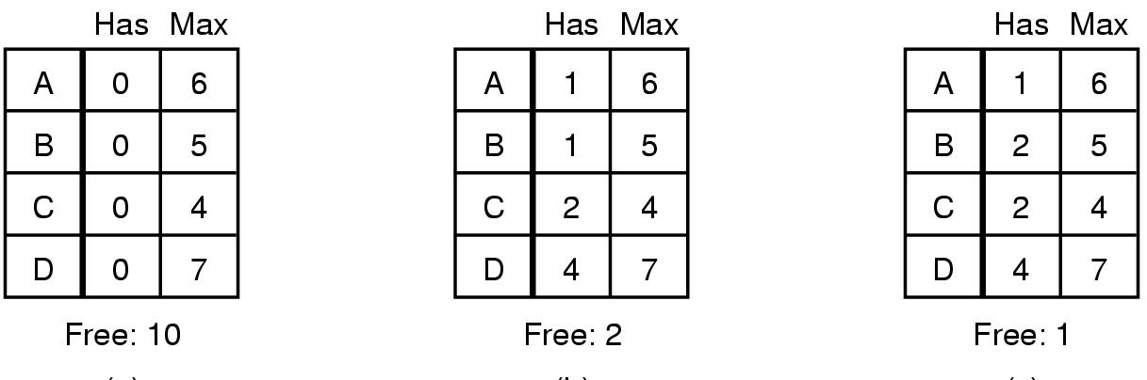
Banker’s Algorithm for a Single Resource (2)
Deadlock Avoidance
At a certain moment, the situation is as shown in Fig. (b). This state is safe because with two units left, the banker can delay any requests except C’s, thus letting C finish and release all four of his resources. With four units in hand, the banker can let either D or B have the necessary units, and so on.
The situation (c) is unsafe. If all the customers suddenly asked for their maximum loans, the banker could not satisfy any of them, and we would have a deadlock. An unsafe state does not have to lead to deadlock, since a customer might not need the entire credit line available, but the banker cannot count on this behavior.
(a) (b) (c)
Three resource allocation states: (a) safe, (b) safe, (c) unsafe

Slide 37
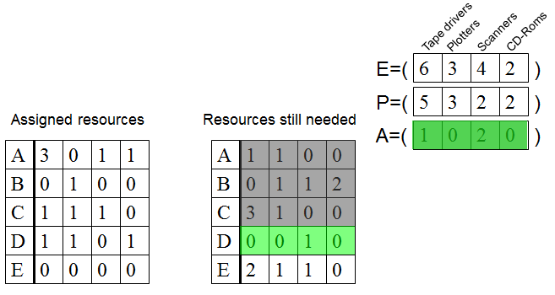
Banker’s Algorithm for Multiple Resources (1)
Deadlock Avoidance
In Fig. we see two matrices.
(a) shows how many of each resource are currently assigned to each of the fiv e processes.
(b) shows how many resources each process still needs in order to complete.
The three vectors at the right of the figure show the existing resources, E, the possessed resources, P, and the available resources, A, respectively.
As in the single-resource case, processes must state their total resource needs before executing, so that the system can compute the right-hand matrix at each instant.
(a) (b)
The banker’s algorithm with multiple resources.
From E we see that the system has six tape drives, three plotters, four printers, and two Blu-ray drives. Of these, fiv e tape drives, three plotters, two printers, and two Blu-ray drives are currently assigned. This fact can be seen by adding up the entries in the four resource columns in the left-hand matrix. The available resource vector is just the difference between what the system has and what is currently in use.

Slide 38
Banker’s Algorithm for Multiple Resources (1)
Deadlock Avoidance
Tape drivers
CD-Roms
Plotters
Scanners
E=(
6
3
4
2
)
P=(
5
3
2
2
)
Assigned resources
Resources still needed
A=(
1
0
2
0
)
A
3
0
1
1
A
1
1
0
0
B
0
1
0
0
B
0
1
1
2
C
1
1
1
0
C
3
1
0
0
D
1
1
0
1
D
0
0
1
0
E
0
0
0
0
E
2
1
1
0
An example for the deadlock detection algorithm

Slide 39
Banker’s Algorithm for Multiple Resources (1)
Deadlock Avoidance
Tape drivers
CD-Roms
Plotters
Scanners
E=(
6
3
4
2
)
P=(
4
2
2
1
)
Assigned resources
Resources still needed
A=(
2
1
2
1
)
A
3
0
1
1
A
1
1
0
0
B
0
1
0
0
B
0
1
1
2
C
1
1
1
0
C
3
1
0
0
D
0
0
0
0
D
-
-
-
-
E
0
0
0
0
E
2
1
1
0
An example for the deadlock detection algorithm

Slide 40
Banker’s Algorithm for Multiple Resources (1)
Deadlock Avoidance
Tape drivers
CD-Roms
Plotters
Scanners
E=(
6
3
4
2
)
P=(
1
2
1
0
)
Assigned resources
Resources still needed
A=(
5
1
3
2
)
A
0
0
0
0
A
-
-
-
-
B
0
1
0
0
B
0
1
1
2
C
1
1
1
0
C
3
1
0
0
D
0
0
0
0
D
-
-
-
-
E
0
0
0
0
E
2
1
1
0
An example for the deadlock detection algorithm

Slide 41
Banker’s Algorithm for Multiple Resources (1)
Deadlock Avoidance
Tape drivers
CD-Roms
Plotters
Scanners
E=(
6
3
4
2
)
P=(
1
1
1
0
)
Assigned resources
Resources still needed
A=(
5
2
3
2
)
A
0
0
0
0
A
-
-
-
-
B
0
0
0
0
B
-
-
-
-
C
1
1
1
0
C
3
1
0
0
D
0
0
0
0
D
-
-
-
-
E
0
0
0
0
E
2
1
1
0
An example for the deadlock detection algorithm

Slide 42
Banker’s Algorithm for Multiple Resources (1)
Deadlock Avoidance
Tape drivers
CD-Roms
Plotters
Scanners
E=(
6
3
4
2
)
P=(
0
0
0
0
)
Assigned resources
Resources still needed
A=(
6
3
4
2
)
A
0
0
0
0
A
-
-
-
-
B
0
0
0
0
B
-
-
-
-
C
0
0
0
0
C
-
-
-
-
D
0
0
0
0
D
-
-
-
-
E
0
0
0
0
E
2
1
1
0
An example for the deadlock detection algorithm

Slide 43
Banker’s Algorithm for Multiple Resources (1)
Deadlock Avoidance
Tape drivers
CD-Roms
Plotters
Scanners
SAFE
E=(
6
3
4
2
)
P=(
5
3
2
2
)
Assigned resources
Resources still needed
A=(
1
0
2
0
)
A
3
0
1
1
A
1
1
0
0
B
0
1
0
0
B
0
1
1
2
C
1
1
1
0
C
3
1
0
0
D
1
1
0
1
D
0
0
1
0
E
0
0
0
0
E
2
1
1
0
An example for the deadlock detection algorithm

Slide 44
Banker’s Algorithm for Multiple Resources (2)
Deadlock Avoidance
The algorithm for checking to see if a state is safe can now be stated.
1. Look for a row, R, whose unmet resource needs are all smaller than or equal to A. If no such row exists, the system will eventually deadlock since no process can run to completion (assuming processes keep all resources until they exit).
2. Assume the process of the chosen row requests all the resources it needs (which is guaranteed to be possible) and finishes. Mark that process as terminated and add all of its resources to the A vector.
3. Repeat steps 1 and 2 until either all processes are marked terminated (in which case the initial state was safe) or no process is left whose resource needs can be met (in which case the system was not safe).

Slide 45
Deadlock Prevention
Having seen that deadlock avoidance is essentially impossible, because it requires information about future requests, which is not known, how do real systems avoid deadlock? The answer is to go back to the four conditions stated by Coffman (1971) to see if they can provide a clue. If we can ensure that at least one of these conditions is never satisfied, then deadlocks will be structurally impossible (Havender, 1968).

Slide 46
R: Conditions for Resource Deadlocks
Deadlock Prevention
1. Mutual exclusion condition. Each resource is either currently assigned to exactly one process or is available.
2. Hold-and-wait condition. Processes currently holding resources that were granted earlier can request new resources.
3. No-preemption condition. Resources previously granted cannot be forcibly taken away from a process. They must be explicitly released by the process holding them.
4. Circular wait condition. There must be a circular list of two or more processes, each of which is waiting for a resource held by the next member of the chain.
Notes:
Gjensidig utelukkelse
Hold og vent
Ingen

Slide 47
Attacking the Mutual Exclusion Condition
Deadlock Prevention
Some devices (such as printer) can be spooled
only the printer daemon uses printer resource
thus deadlock for printer eliminated
Not all devices can be spooled
Principle:
avoid assigning resource when not absolutely necessary
as few processes as possible actually claim the resource

Slide 48
Attacking Hold and Wait Condition
Deadlock Prevention
Require processes to request resources before starting
A process never has to wait for what it needs
Telephone companies do this
Problems
May not know required resources at start of run
Also ties up resources other processes could be using
Variation:
Process must give up all resources
Then request all immediately needed

Slide 49
Attacking the No Preemption Condition
Deadlock Prevention
This is not a viable option
Consider a process given the printer
Halfway through its job
No forcibly take away printer
!!??

Slide 50
Attacking the Circular Wait Condition (1)
Deadlock Prevention
A
CD Rom drive
Tape drive
Plotter
Scanner
Imagesetter
1
2
3
4
5
Normally ordered resources
A resource graph

Slide 51
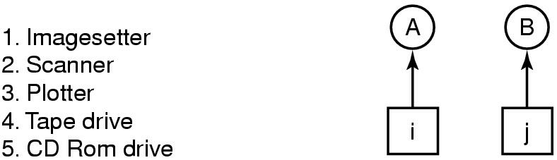
Attacking the Circular Wait Condition (2)
Deadlock Prevention
Only one condition is left. The circular wait can be eliminated in several ways. One way is simply to have a rule saying that a process is entitled only to a single resource at any moment. If it needs a second one, it must release the first one. For a process that needs to copy a huge file from a tape to a printer, this restriction is unacceptable. Another way to avoid the circular wait is to provide a global numbering of all the resources, as shown in Fig. (a). Now the rule is this: processes can request resources whenever they want to, but all requests must be made in numerical order. A process may request first a printer and then a tape drive, but it may not request first a plotter and then a printer.
(a) (b)
(a) Numerically ordered resources. (b) A resource graph.

Slide 52
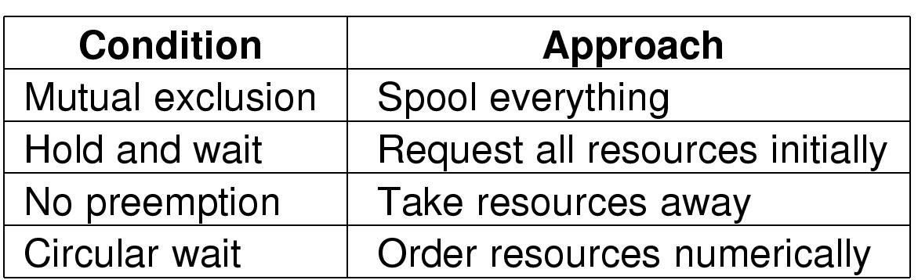
Deadlock Prevention Overview
Deadlock Prevention
Summary of approaches to deadlock prevention

Slide 53
Non-resource Deadlocks
Possible for two processes to deadlock
Each is waiting for the other to do some task
Can happen with semaphores
Each process required to do a down() on two semaphores (mutex and another)
If done in wrong order, deadlock results

Slide 54
Summary
Resource
Introduction to deadlocks
Strategies
Ostrich algorithm
Deadlock detection and recovery
Deadlock avoidance
Deadlock prevention
Non-resource deadlocks

